Slide 1
Second-hand Market Web Application Final presentation
Team Members: Tang Yi, Shuwen Luo, Zhongrui Zhao, Yelu Wang, Yihan Xie, Zhen Hu, Jiabei Song, Yinan Pan, Jiazhi Sun
Flag Camp Team 03
July 13, 2025

Slide 2
Project Introduction
The second-hand trading market often suffers from fake advertisements and low-quality, mismatched buyers.
To solve this, we aim to build a reliable and secure application for students in City X.
This web application will allow:
Sellers to post listings
Buyers to view nearby available items via a list or map
Real-time communication between buyers and sellers Ultimately, it improves trust and safety in student-to-student transactions.

Slide 3
Main Features
1. User Authentication System
User Registration – Create a new user account
User Login – Log in with an existing account
JWT Authentication – Secure identity verification
User Profile Management – View and edit personal information
2. Product Management System
Product Listing – Sellers post second-hand product info
Product Browsing – Buyers browse all available products
Product Search – Search by keywords
Product Details – View detailed information
Product Deletion – Sellers delete their own listings
3. Real-Time Chat System
Chat Room Creation – Buyers and sellers open private chats
Message Sending – Send and receive messages in real time
Chat History – View and store past messages
Chat Room List – Manage all chat sessions
4. File Upload Feature
Product Image Upload – Add images to product listings
File Management – Upload and manage various files

Slide 4
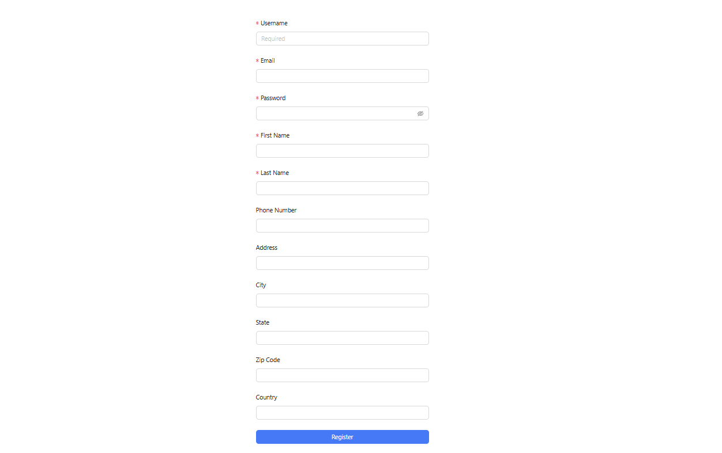
1.
User Authentication
User Registration – Create a new user account

Slide 5
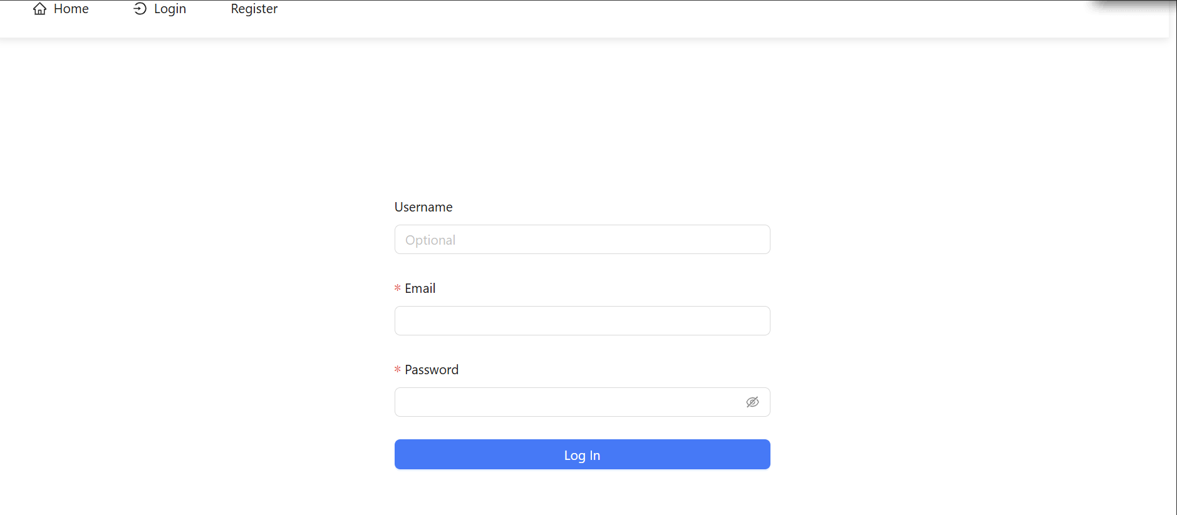
1.
User Authentication
User Login – Log in with an existing account

Slide 6
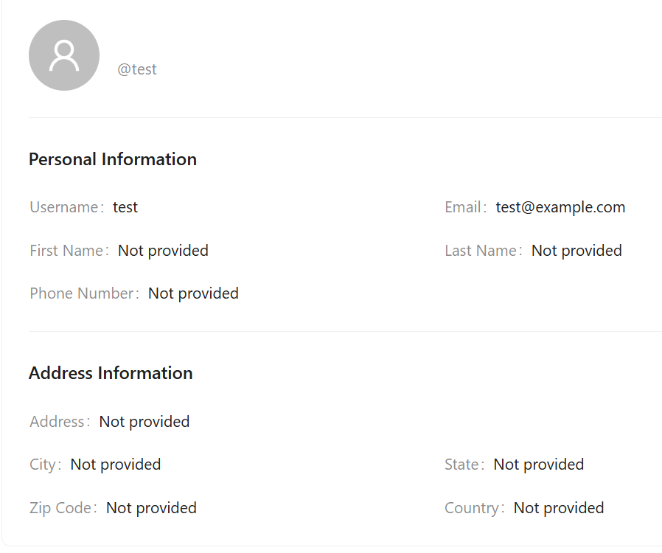
1.
User Authentication
User Profile Management –
View and edit personal information

Slide 7
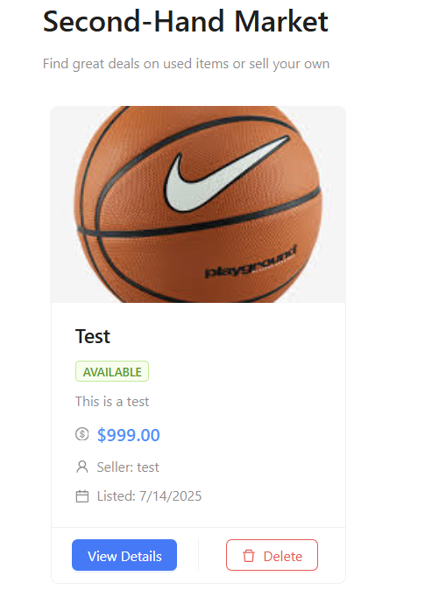
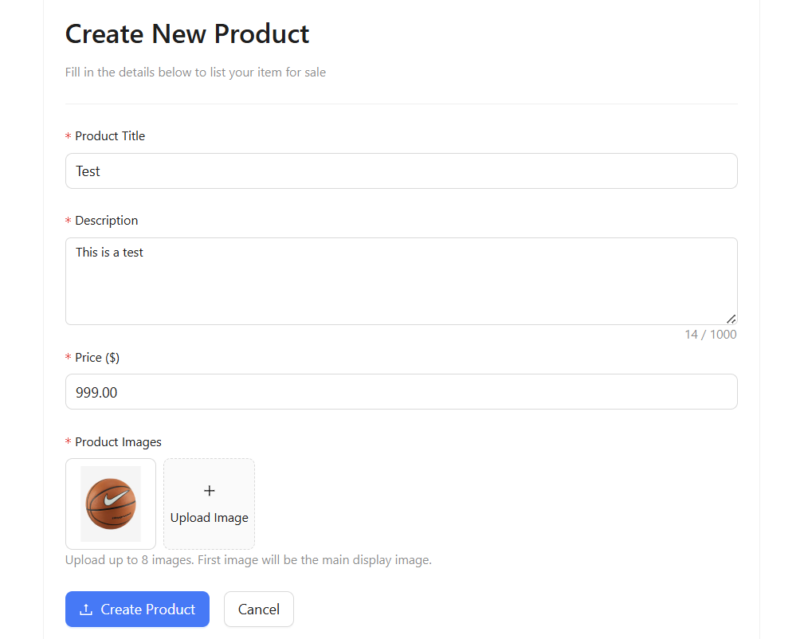
2. Product Management System
Product Listing – Sellers post second-hand product info

Slide 8
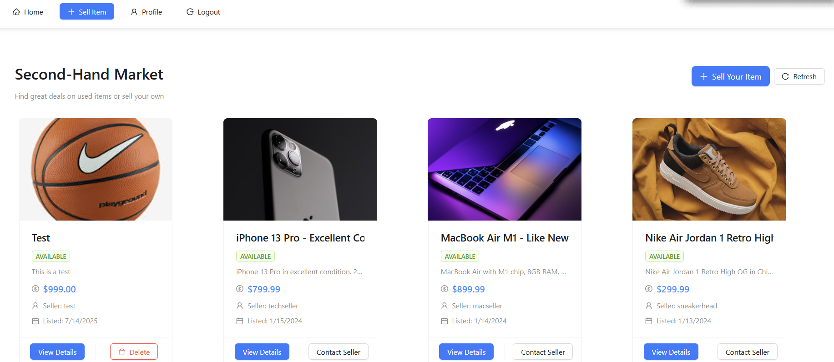
2. Product Management System
Product Browsing – Buyers browse all available products

Slide 9
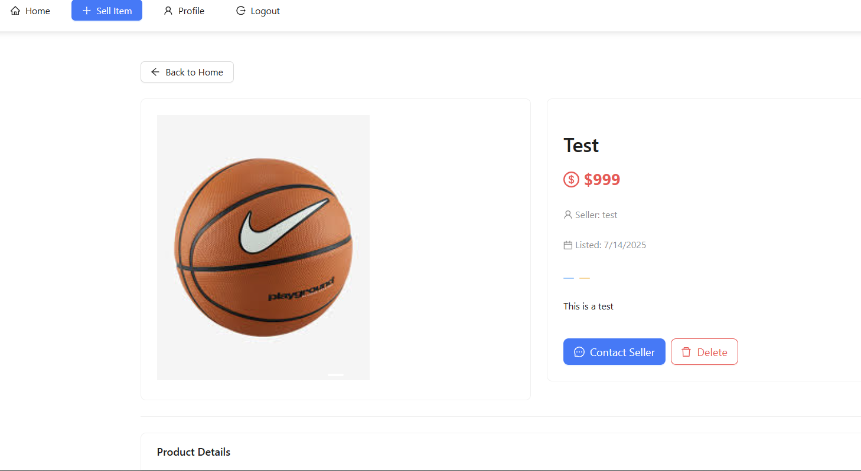
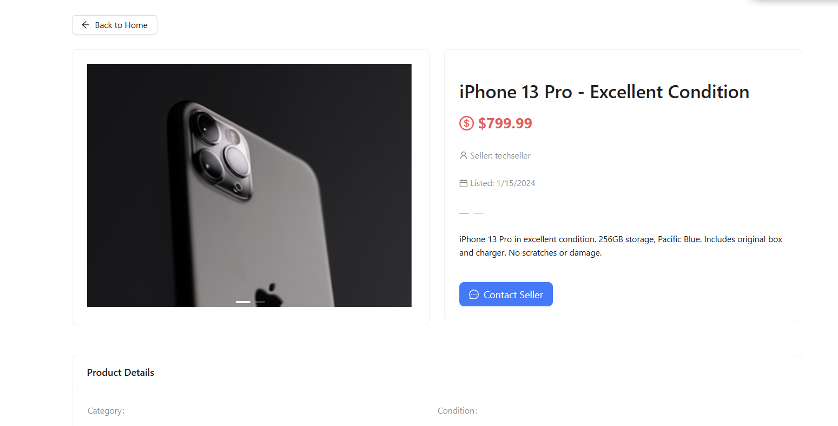
2. Product Management System
Product Details – View detailed information

Slide 10
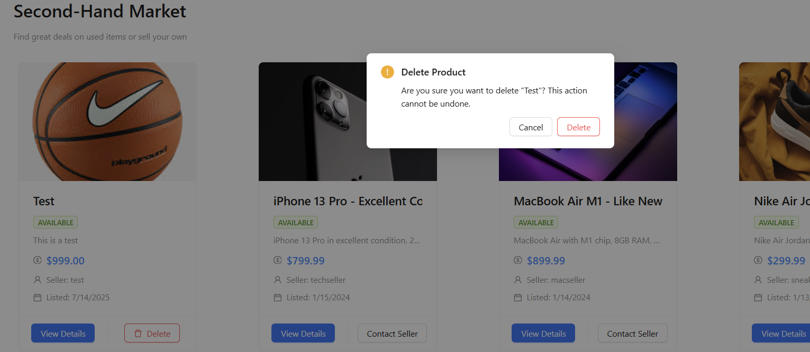
2. Product Management System
Product Deletion – Sellers delete their own listings

Slide 11
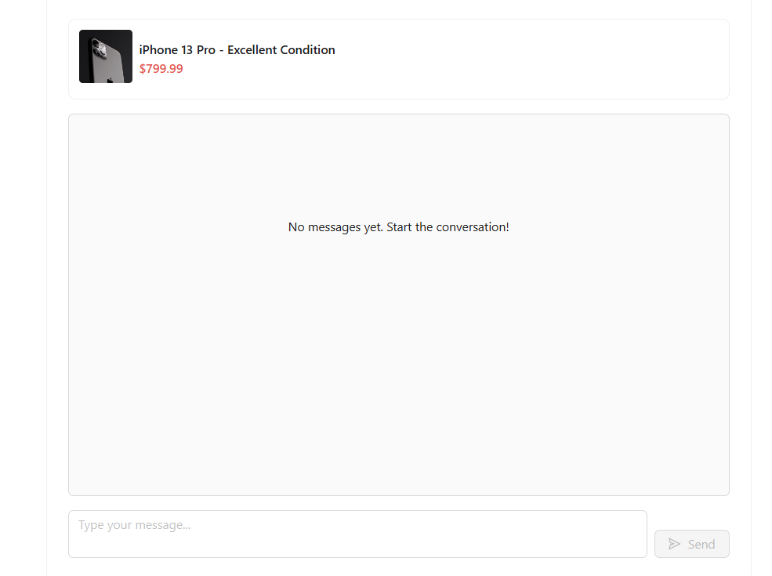
3. Real-Time Chat System
Chat Room Creation – Buyers and sellers open private chats

Slide 12
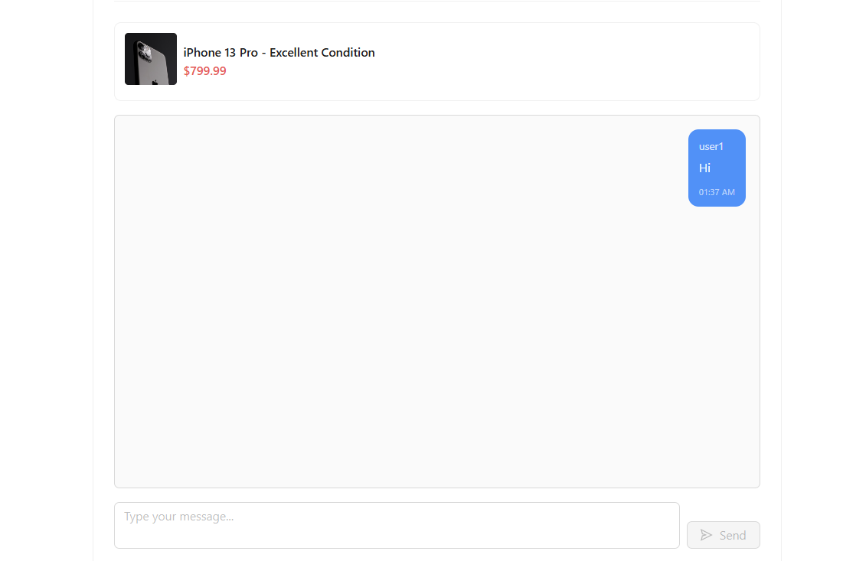
3. Real-Time Chat System
Message Sending – Send and receive messages in real time

Slide 13
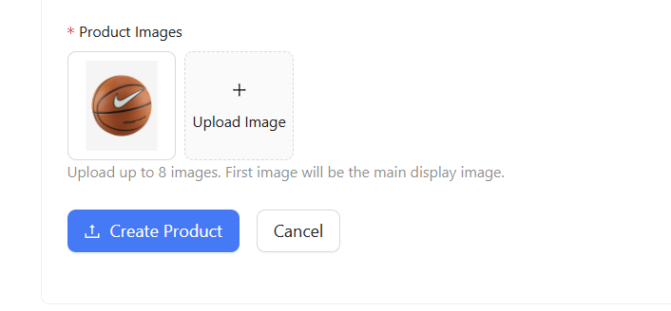
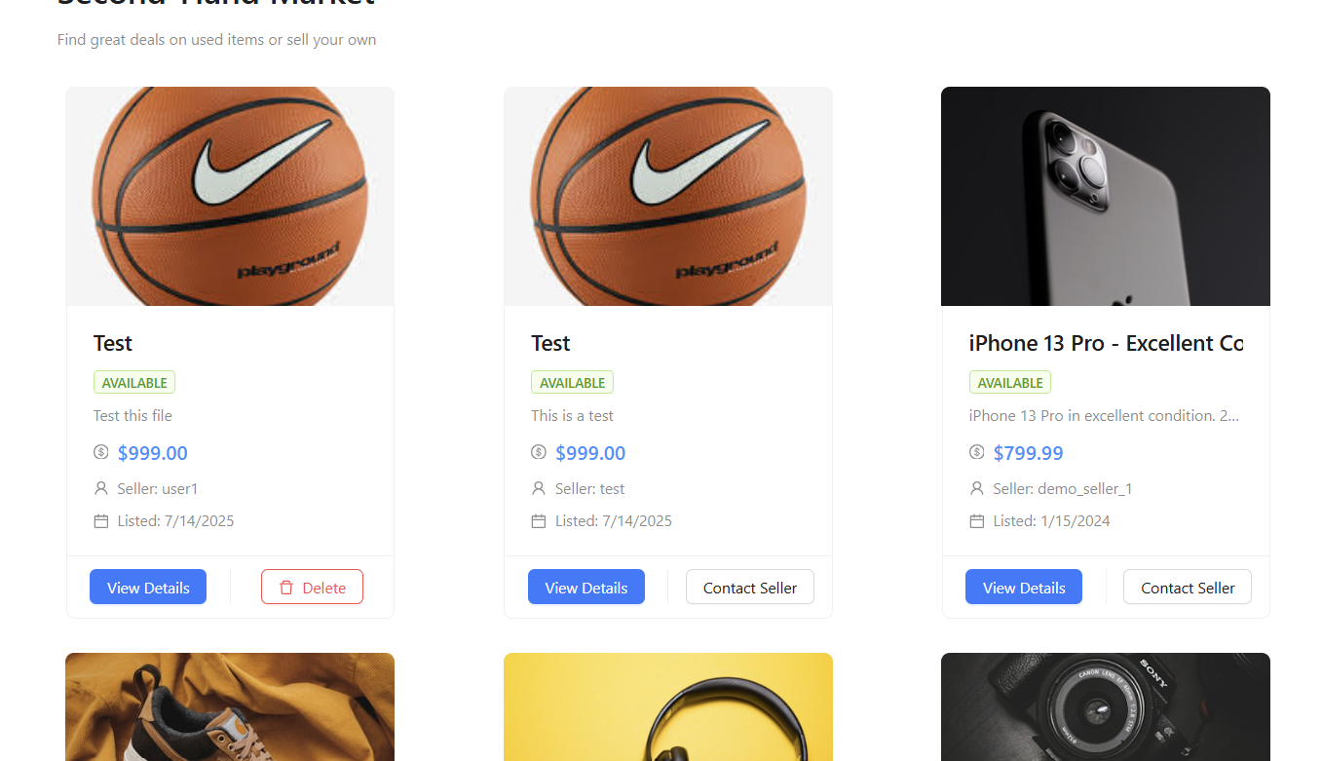
4. File Upload Feature
Product Image Upload – Add images to product listings

Slide 14
System Architecture
🔧 Backend Tech Stack (Spring Boot)
Core Framework
Spring Boot 3.x – Main framework for rapid development
Spring Security – Authentication and authorization
Spring Data JPA – Data persistence
Spring Web MVC – Web controller layer
Database & Storage
H2 Database – In-memory DB for development
JPA/Hibernate – ORM framework
HikariCP – High-performance connection pool
Authentication & Security
JWT (JSON Web Token) – Stateless authentication
BCrypt – Password hashing
Spring Security – Filter chain for access control
API Design
RESTful APIs – Standard REST interface
CORS – Cross-origin configuration
JSON – Data exchange format
Development Tools
Gradle – Build tool
Spring Boot DevTools – Hot reload for development

Slide 15
🎨 Frontend Tech Stack (React + TypeScript)
Core Framework
React 18 – UI library
TypeScript – Type-safe JavaScript
Vite – Fast build tool
State Management
Zustand – Lightweight state management
React Context – Shared state across components
Routing
React Router v6 – SPA routing
UI & Styling
Tailwind CSS – Utility-first CSS framework
Custom Components – Project-specific UI components
HTTP Client
Fetch API – Native HTTP requests
Custom API Handler – Unified request logic
Development Tools
Vite Dev Server – Local dev server
ESLint – Code quality checker
TypeScript Compiler – Static typing

Slide 16
🔄 Communication Protocols
HTTP / HTTPS
RESTful API – Standard HTTP methods
JSON – Data serialization
Bearer Token – JWT in Authorization header
WebSocket (for chat)
Real-time messaging
Full-duplex communication
📊 Data Models
Core Entities
User – User info
Item – Product info
ChatRoom – Chat room
Message – Message history
Entity Relationships
One-to-Many – User ↔ Items
Many-to-Many – ChatRoom ↔ Messages

Slide 17
🚀 Deployment Architecture
Development Environment
Local dev with separated frontend & backend
Hot reload
In-memory H2 database
Production Environment
Integrated deployment – frontend build output served by backend
Docker support – via docker-compose.yml
Gradle build – production packaging
🛠️ Dev Toolchain
Version Control
Git – Code versioning
GitHub – Remote repo hosting
Build Tools
Gradle – Java build tool
npm – Node.js package manager
Vite – Frontend build
IDE Support
IntelliJ IDEA – Backend development
VS Code – Frontend development
Spring Boot DevTools – Convenience for local dev

Slide 18
P1 - Key Enhancements to Improve User Experience
🟢 Focus: Enhancing Maps, Reviews, Recommendations, and History
Map View – Display nearby items on a map
User Rating System – Allow users to rate each other after transactions
Transaction History – Both buyers and sellers can view past transactions
Recommended Items – Based on browsing history or location
User Profile Improvements – Add avatar, description, and editable personal info

Slide 19
P2 - Optional Features (Time Permitting)
Mock Payment Flow – Simulate payment process (no need to connect to real payment gateway)
Transaction Status Updates – More detailed status transitions (e.g., “Shipped”, “In Progress”)
Advanced Search – Support fuzzy search and multi-dimensional filters
Frontend Animation Optimization / Mini App / PWA – Improve UI responsiveness and adapt to different platforms
Admin Panel Interface – For managing users and products

Slide 20
Demo Videos

Slide 21
Thanks for listening & watching !

